Slide 1



z
SMART TRANSIT MANAGEMENT SYSTEM
PRESENTED BY TEAM 12

Slide 2
Zeeth K
Gangothri Madduru
Ganesh Nanavath
Sivadharane S
Kothakonda Navadeep
Lakshitha RE
Anisha G
Monalisa Sahu
Mounika Jaya Veerapalli
TEAM MEMBERS

Slide 3

Introduction
The Smart Transit Management System is designed to digitize and simplify public transportation services.
Built on the ServiceNow platform to leverage its workflows, catalog, and portal capabilities.
Enables passengers to book tickets, track transit services, and manage schedules through a self-service portal.
Provides administrators with dashboards for monitoring, analytics, and service management.

Slide 4





Problem Statement
Current transit systems often face:
Manual booking & ticketing delays
Lack of real-time tracking & transparency
No centralized platform for passengers and operators
Limited reporting and analytics for administrators
This leads to poor passenger experience and inefficient management.

Slide 5
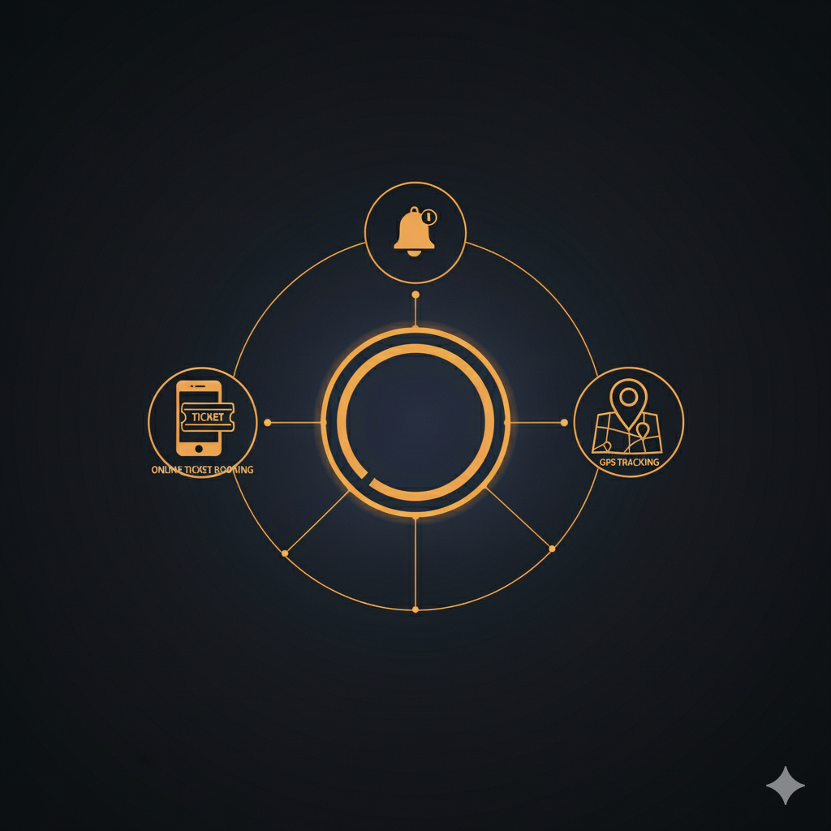
Solution
A centralized digital portal for Smart Transit services in ServiceNow.
Capabilities:
Online ticket booking & management
Service Catalog for different transit services
Dashboards for administrators to monitor bookings & performance
Knowledge Base & FAQs for passenger support
Automated notifications & approvals (e.g., booking confirmation)

Slide 6
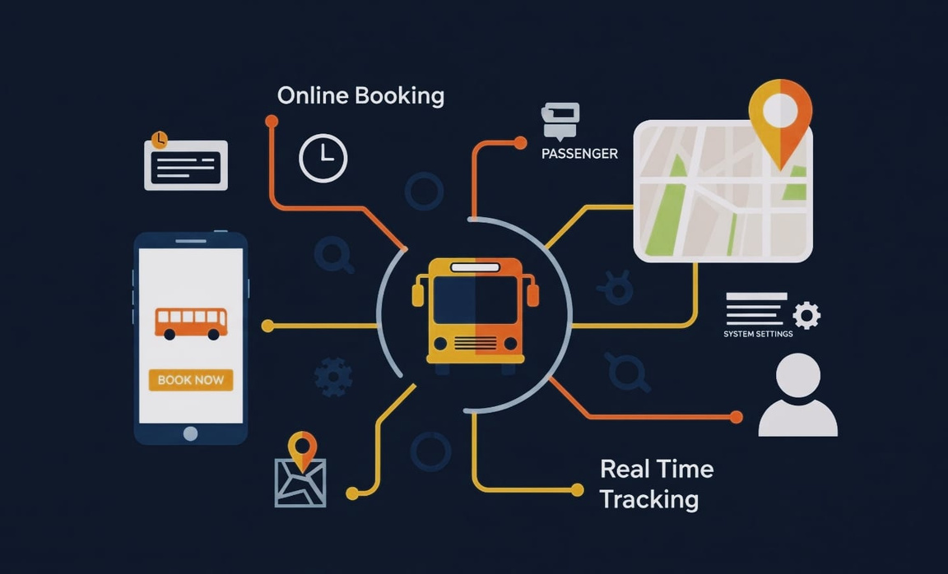
Features
Passenger Side
Ticket booking, cancellation, and history
Service catalog for different transport options
Real-time booking confirmation & notifications
Admin Side
Manage bookings & services
Generate reports & insights
Track system performance with dashboards

Slide 7
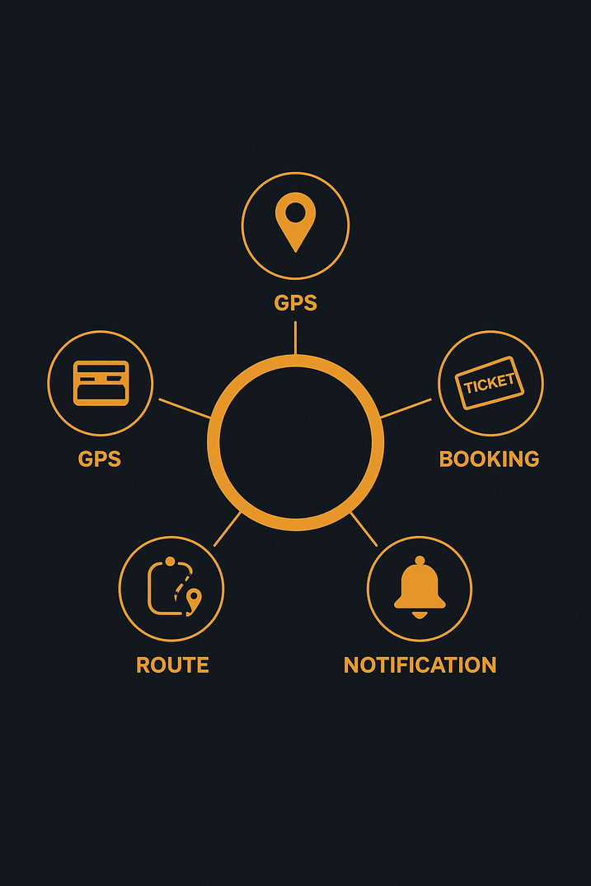
Key Requirements
Create a Service Catalog for booking bus tickets.
Implement record producers/catalog items for route selection and booking.
Provide real-time updates on bus schedules and availability.
Enable admin dashboard for route management and ticket monitoring.
Notifications to users for booking confirmations/cancellations.

Slide 8


Challenges Faced
Understanding ServiceNow catalog vs record producers.
Difficulty in linking multiple tables (bus, route, booking).
Handling notifications without complex flows.
UI customization limitations inside ServiceNow Studio.

Slide 9
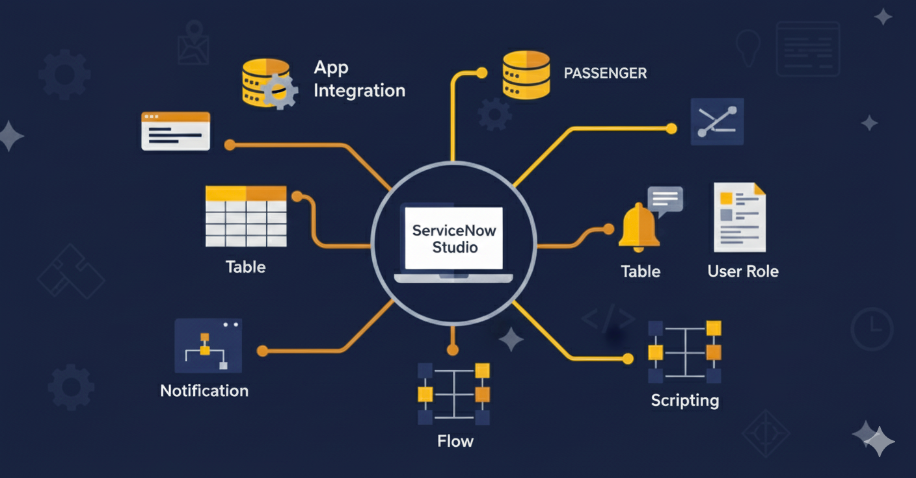
Technology Stack
ServiceNow Studio (for application development).
Service Catalog & Record Producers (for booking process).
Tables & Forms (to store bus, route, and booking data).
Workflows/Flow Designer (to handle automation).
Notifications (email/SMS confirmation)

Slide 10

Application Demo
User books a ticket via Bus Services Catalog Item.
System checks seat availability and confirms booking.
Automatic notification/email sent to the customer.
Admin can monitor bookings and bus schedules
from the backend.

Slide 11

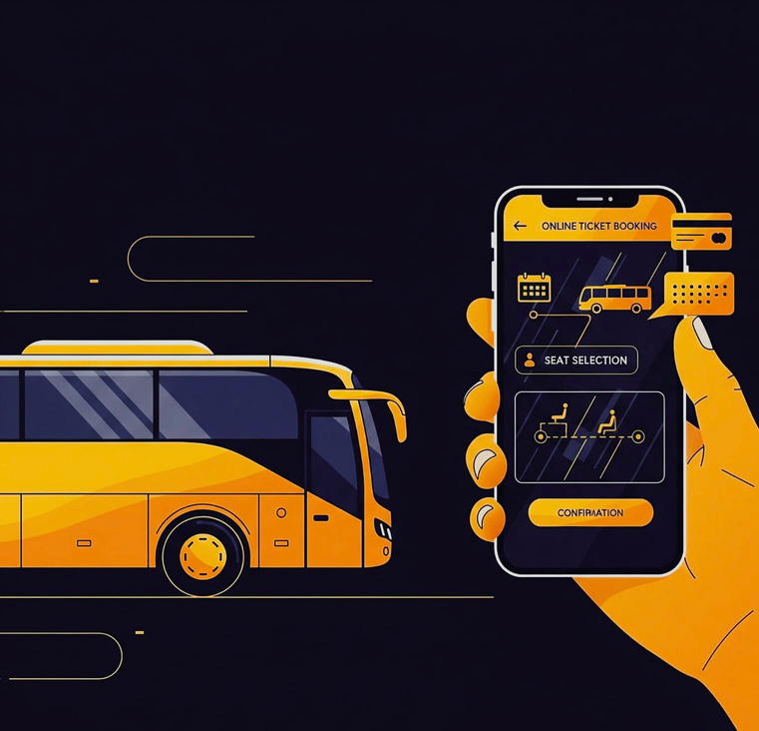
Result
Developed a centralized Bus Transit Management System on the ServiceNow platform.
Enabled passengers to book, cancel, and track tickets seamlessly.
Provided administrators with a dashboard to manage routes, services, and bookings.
Implemented automated notifications for real-time
booking confirmations and updates.
Achieved greater efficiency, transparency, and reliability in
bus transit operations.

Slide 12

Future Enhancement
Mobile-Friendly App for passengers to book tickets easily
Real-Time Bus Tracking using GPS integration
Online Payment Gateway for secure transactions
AI-Powered Predictions for seat demand and route optimization
Advanced Analytics Dashboards for admins
Role-Based Access for passengers, drivers, and admins

Slide 13

Thank you!
PRESENTED BY TEAM 12

